Slide 1

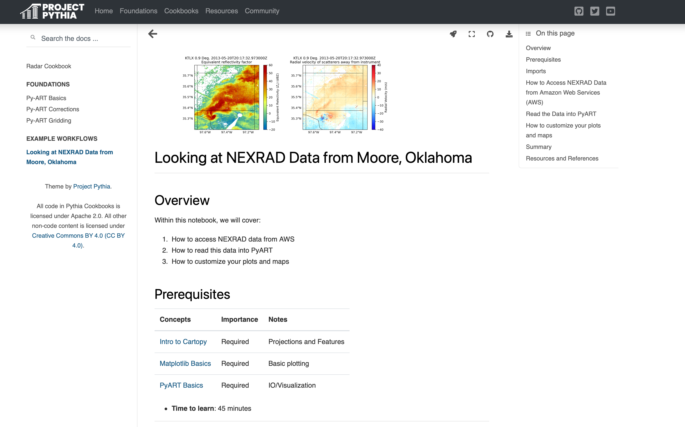
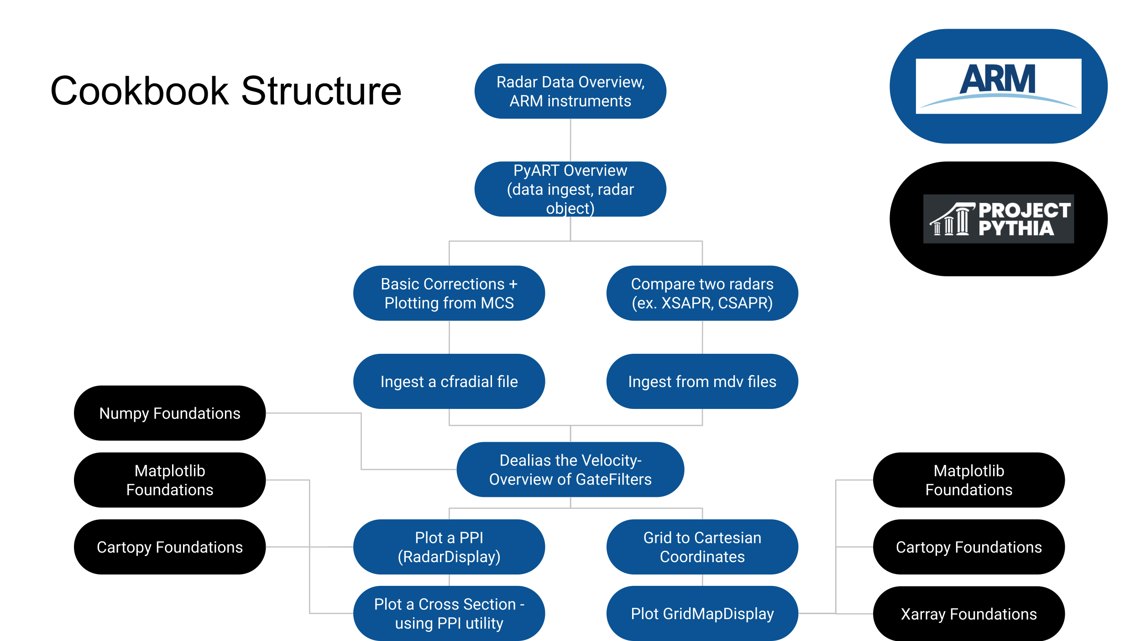



Open Science analysis cookbooks were developed, focusing on working with weather radars.
Opening ARM: Developing Open-Science Cookbooks Leveraging Users, Data, and Infrastructure
Sherman¹
Foundational Material
Py-ART Basics
General overview of Py-ART
Reading radar data
Overview of the Radar Object
Plotting radar data
Py-ART Corrections
Introduction to radar aliasing
Velocity Texture Calculation
Dealiasing the Velocity field
Py-ART Gridding
What is gridding and why does it matter
An overview of gridding with Py-ART
Examples
Plotting a storm in Oklahoma from data on Amazon Web Services
PRESENTER:
Maxwell Grover¹
BACKGROUND: We developed scientific analysis cookbooks, extending upon foundational Python material from Project Pythia, focused around working with radar weather data.
Py-ART is an open-source Python package focused on reading, cleaning, and plotting weather radar data, funded by the Atmosphere Radiation Measurement (ARM) Facility
METHODS
Collected previous Py-ART tutorial materials
Outlined what the “foundational” material
Determined which Project Pythia foundational material we could link to
Here is an example flowchart showing this process
RESULTS
We put together a cookbook that links to existing Project Pythia Foundational Materials, and extends the material to include working with Py-ART for radar data
Maxwell Grover¹, Zachary Sherman¹, Scott Collis¹, Jitendra Kumar², Adam Thiesen¹, Bobby Jackson¹, Kevin Tyle³, Julia Kent⁴, Drew Camron⁵
Visualize your findings with an image, graphic, or a key figure.
¹Argonne National Laboratory
²Oak Ridge National Laboratory
³University at Albany
⁴National Center for Atmospheric Research
⁴Unidata Program Office
Take a picture to checkout the cookbook
Notes:
Notes:
In Powerpoint, click View > Guides
Keep text within gutter guides.
Author list: Don’t split names onto two lines (e.g., “Jimmy [break] Smith”). If that happens, use a new line, unless you need the space. Bold the first names of anybody who’s presenting in person.
Intro/methods/result: Do not drop below font size 28, but if you have extra space, jack up the font size until the space is full.
Do not use color in the sidebars except in graphs/figures. It’ll pull attention from the center and slow interpretation for passersby.

